Slide 1
Data Pipeline Design for Heart Disease Dataset
Sanjeeb Adhikari

Slide 2
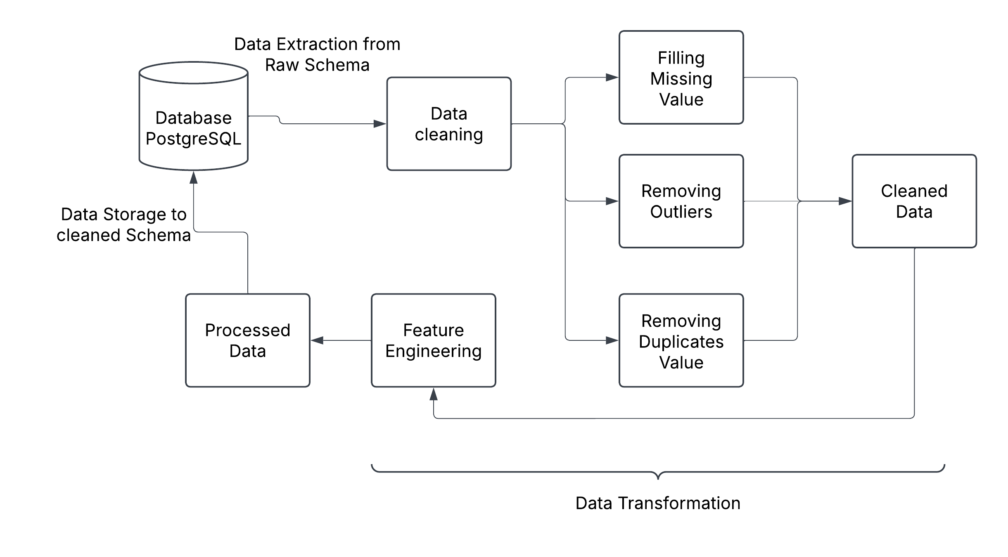
Diagram of the Data Pipeline
Notes:
Steps of Data Pipelines: 1. Data Extraction: Firstly, a raw data was extracted from the Raw Schema from database which contains the raw dataset.
2. Data Transformation: Then the raw data were processed by cleaning or filling missing vales, removing outliers that may biased our outcomes and removing duplicate vales. Also, in this process, some features were removed that least helps to get target. [In my case I removed ca column (Number of major vessels (0-3) colored by fluoroscopy) as it has almost 90% missing values.].
3. Data Storage: Then the processed data was stored to cleaned schema of my database MSDS610 database.

Slide 3
Pipeline Type
Batch Processing
Since, the dataset doesn’t require real-time updates
We can process the data in chunks at scheduled intervals
Notes:
Pipeline Type: Batch Processing
- The dataset contains different measurement related to heart disease and this dataset doesn’t require real time updates as we could use collected data in certain intervals like day or week or month.

Slide 4
Data Format
The processed data was stored in database in new schema and table.
A new Cleaned Schema was made and the data were stored there.
Notes:
Data Format:
The processed data was stored to a database in a new schema named “Cleaned”. Since, we extract data from database and aim is to store transformed data in database for further processing so in this case the dataset was saved in database.

Slide 5
Data Quality Issues
Missing Values
Outlier
Duplicates values
Notes:
1. Missing Values: There was a huge missing value in the dataset in multiple columns. Some of the rows containing missing values were removed and for most of the other missing value the value were filled using Mode and KNN imputer method. Mode was used for categorical or Boolean data and KNN was used for numeric data.
2. Outlier: Although there wasn’t much outlier in dataset while viewing it using plot but two outlier of oldpeak column was eliminated using z-score.
3. Duplicates: Although there was large duplicates value in dataset, but none of them was removed thinking that the measurement of multiple people of same comdition might be same.

Slide 6
Star Schema
Fact Table: Fact_Heart_Disease
Dimension Tables:
Dim_Patient
Dim_Chest_Pain_Type
Dim_Electrocardiographic_Results
Dim_Exercise_Angina
Dim_Thalassemia
Dim_Slope_of_ST_Segment
Notes:
This schema has a central fact table (Fact_Heart_Disease) linked to several dimension tables (Dim_Patient, Dim_Chest_Pain_Type, Dim_Electrocardiographic_Results, Dim_Exercise_Angina, Dim_Slope_of_ST_Segment, Dim_Thalassemia) through foreign keys, creating a star-like structure for easy querying and reporting.

Slide 7
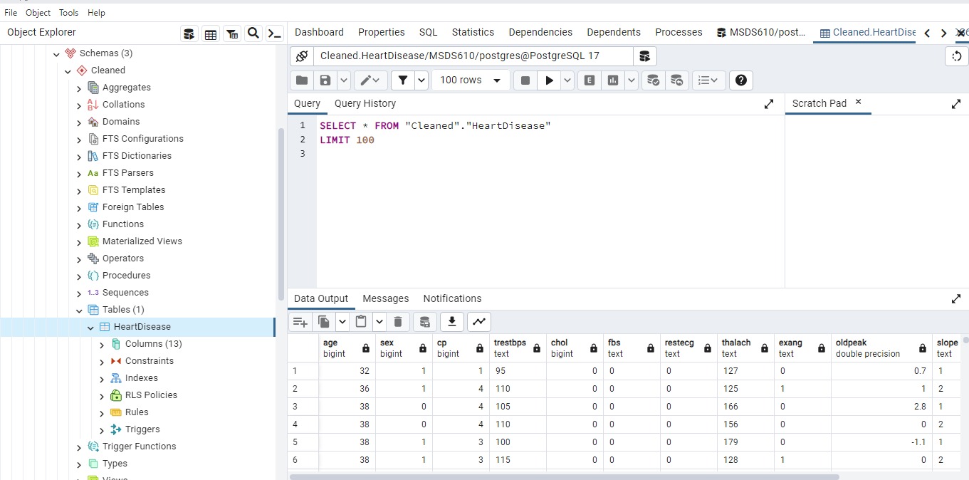
Data Loaded To Cleaned Schema

